Slide 1
Welcome to Instamart
Online Vegetable and Fruit Order app
Presented by : Mayank Modi
Made by : Mayank Modi

Slide 2
introduction
Earlier, fruits and vegetables were the things that mostly relied on physical stores or street shops. Now you no longer need to roam around busy streets to find fresh vegetables because the trend has been changed. People’s inclination towards online vegetable buying is increasing, and this approach has forced retail shop owners to embrace digital solutions for their business.

Slide 3
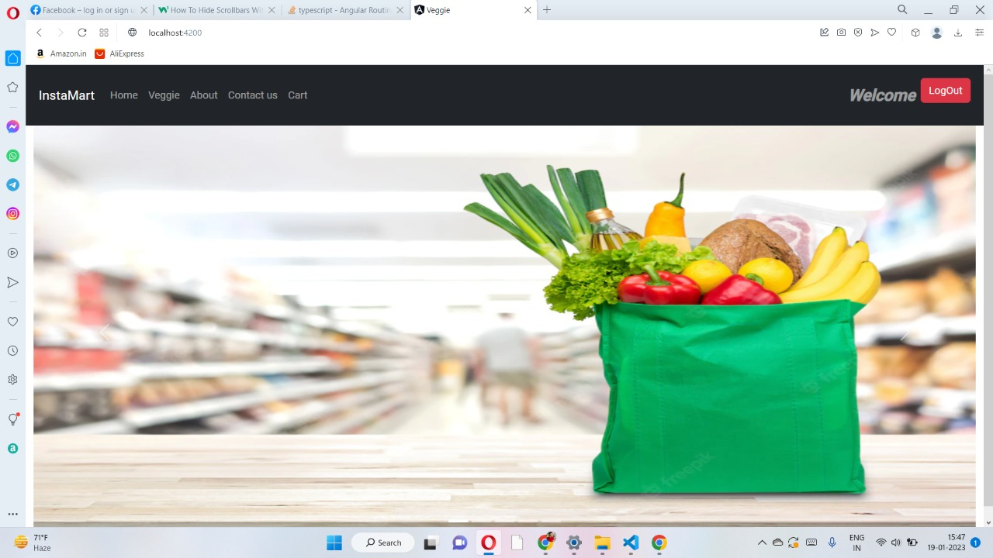
Homepage
Home Page

Slide 4
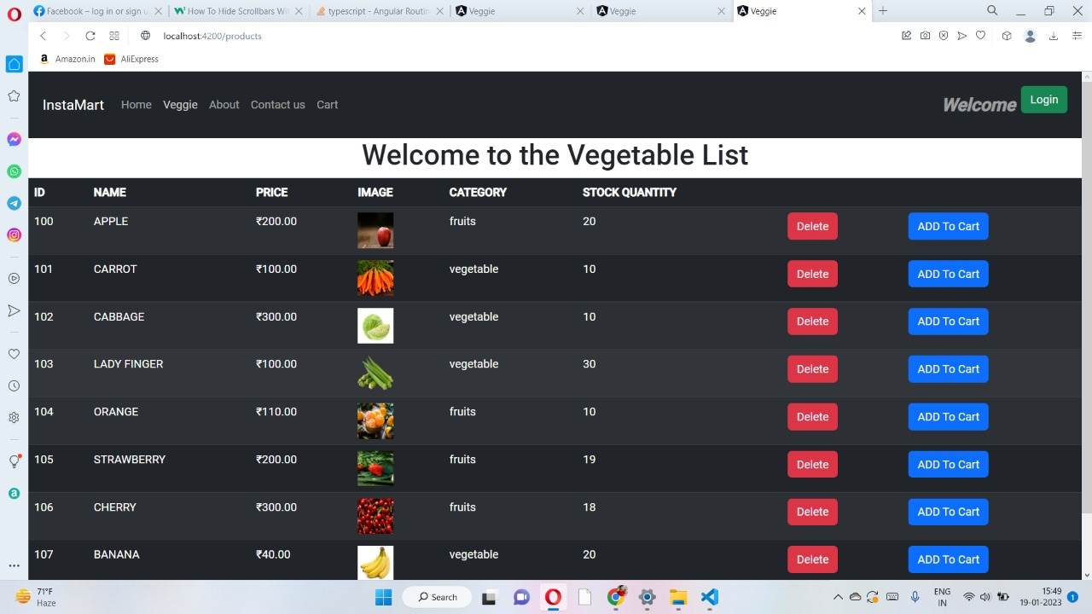
Product List

Slide 5
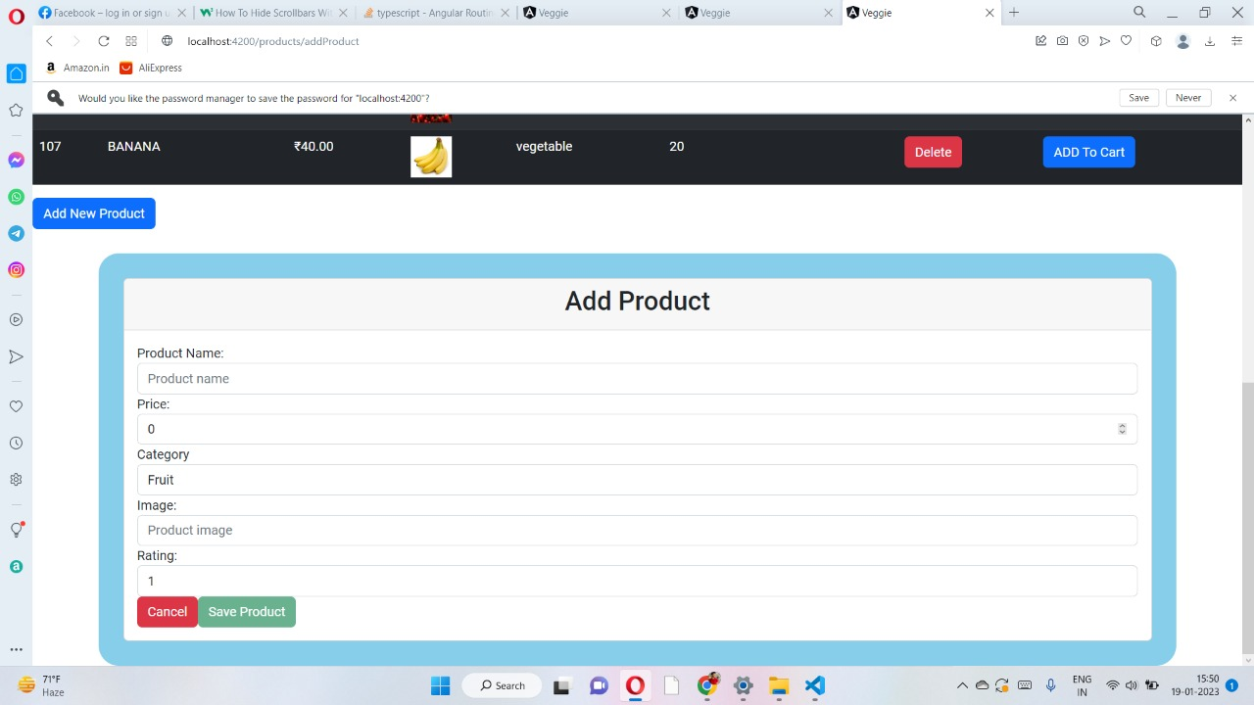
Admin Can perform Add product Task

Slide 6
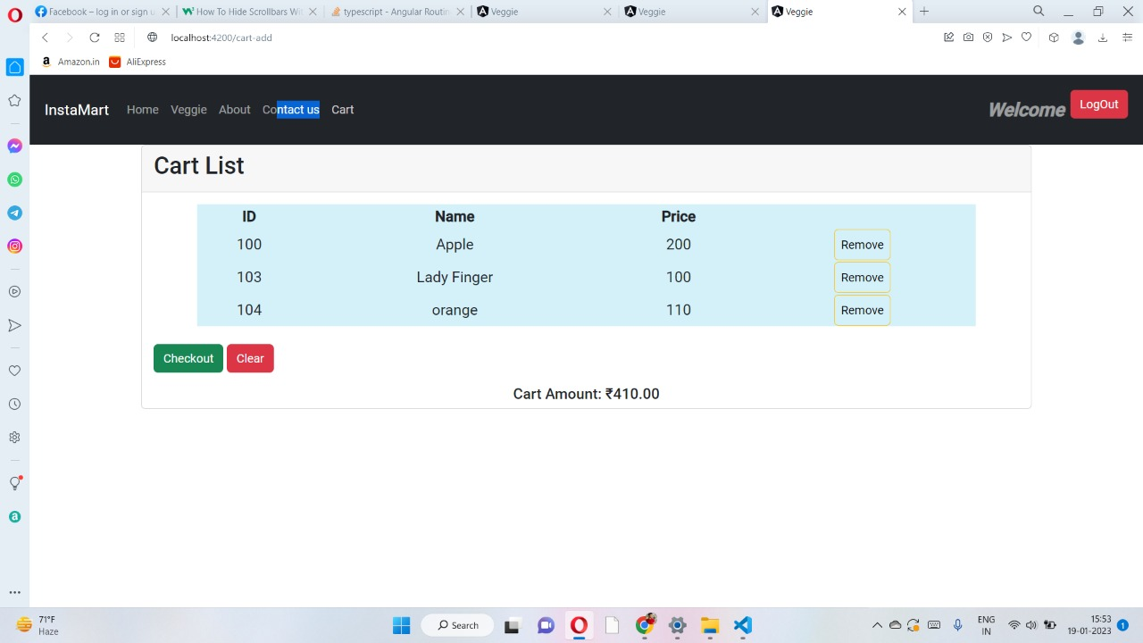
When user click on add to cart it goes in cart

Slide 7
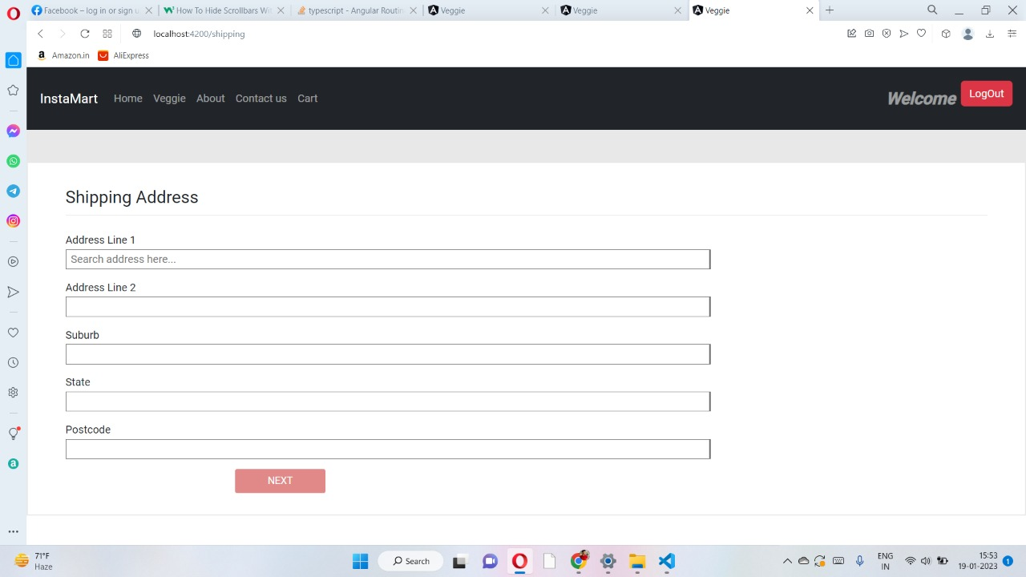
When user click in cart on checkout it comes on shipping address page

Slide 8
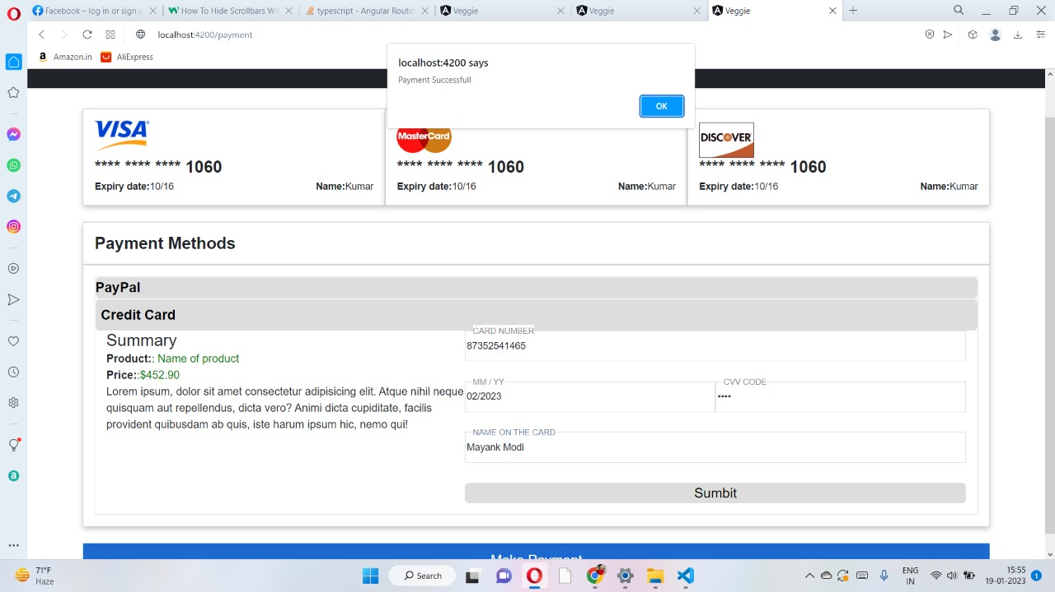
After filling shipping address when user click on next it asks for payment details And after fill payment details it give notification that payment successful and redirect to vegiie list

Slide 9
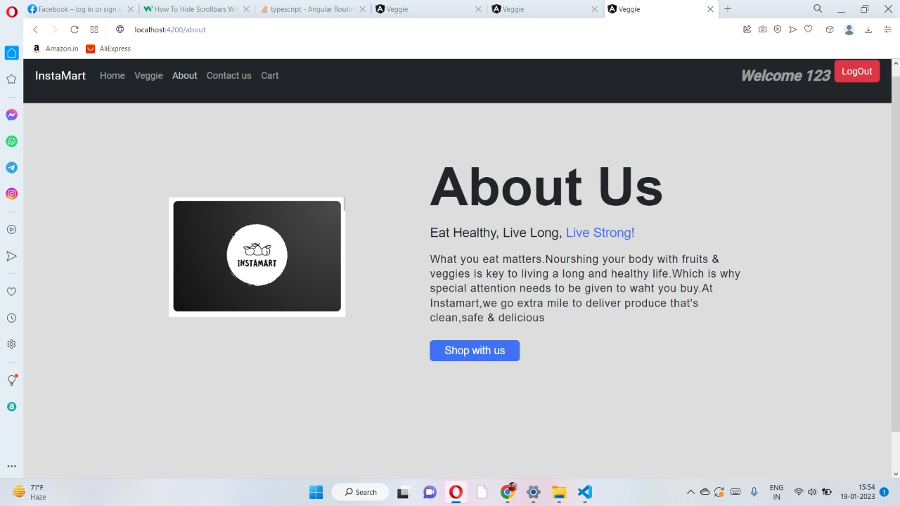
About us page

Slide 10
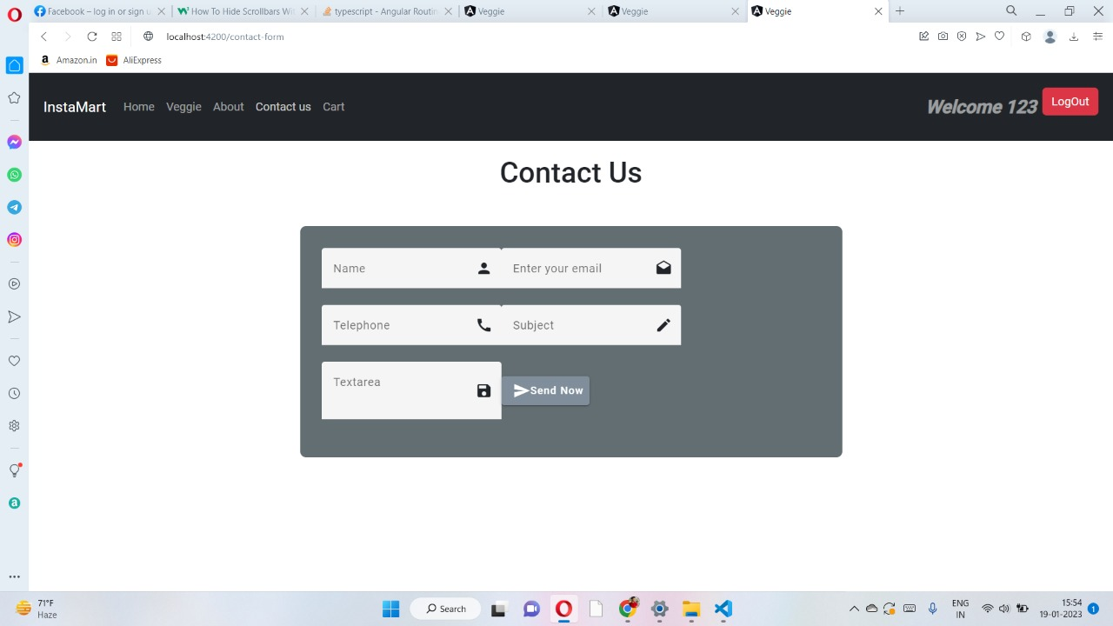
Contact us page for user for queries

Slide 11
THANK YOU
Regards ,
MAYANK MODI

